Slide 1
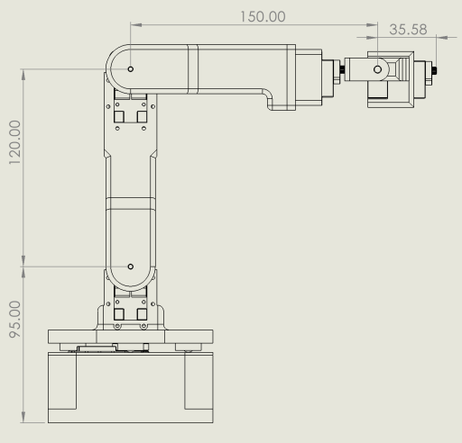
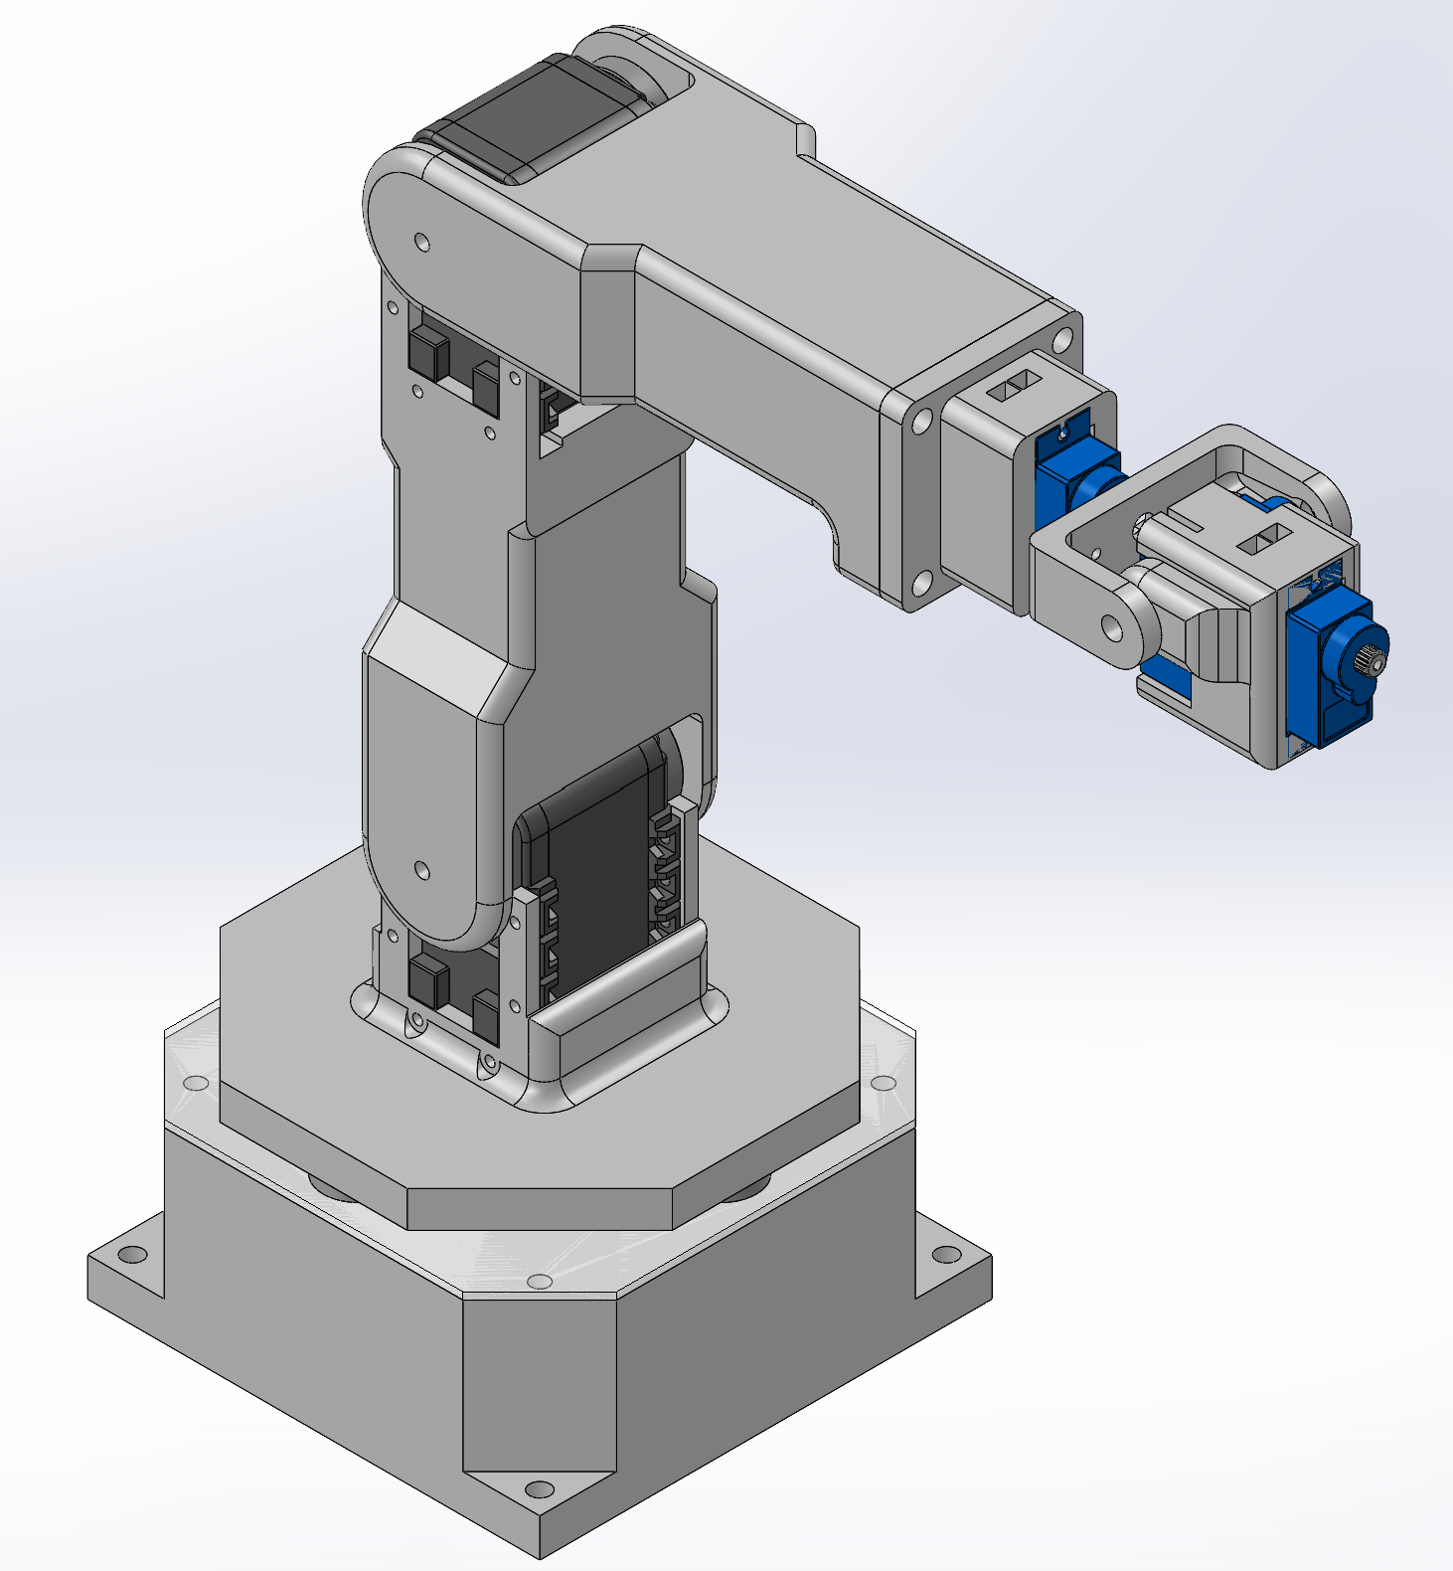

Slide 2
For the first half of the course, we will consider the robot as 6-DOF with spherical wrist for working on kinematics with the concept of screw axes.

Slide 3
X7
X4,5,6
Z7
Z4,6
X3
L4 = 35.6mm
L3 = 150mm
Z5
Z3
L2 = 120mm
Frame | θ | d | a | α
1 to 2 | θ1 | L1 | 0 | -π/2
2 to 3 | θ2 - π/2 | 0 | L2 | 0
3 to 4 | θ3 | 0 | 0 | -π/2
4 to 5 | θ4 | L3 | 0 | π/2
5 to 6 | θ5 | 0 | 0 | -π/2
6 to 7 | θ6 | L4 | 0 | 0
X2
Z2
L1 = 95mm
Z1
X1
Y1

Slide 4
X7
X4,5,6
0 | 0 | 1 | L3+L4
0 | -1 | 0 | 0
1 | 0 | 0 | L1+L2
0 | 0 | 0 | 1
Z7
Z4,6
X3
M =
L4 = 35.6mm
L3 = 150mm
Z5
Z3
L2 = 120mm
w1 = [0 0 1] | p1 = [0 0 0] | v1 = -w1 x p1 | S1 = [w1 v1]^{T}
w2 = [0 1 0] | p2 = [0 0 L1] | v1 = -w1 x p1 | S1 = [w1 v1]^{T}
w3 = [0 1 0] | p3 = [0 0 L1+L2] | v1 = -w1 x p1 | S1 = [w1 v1]^{T}
w4 = [1 0 0] | p4 = [L3 0 L1+L2] | v1 = -w1 x p1 | S1 = [w1 v1]^{T}
w5 = [0 1 0] | p5 = [L3 0 L1+L2] | v1 = -w1 x p1 | S1 = [w1 v1]^{T}
w6 = [1 0 0] | p6 = [L3 0 L1+L2] | v1 = -w1 x p1 | S1 = [w1 v1]^{T}
X2
Z2
L1 = 95mm
Z1
X1
Y1

Slide 5
For the second half of the course, we will completely ignore (or even remove) the spherical wrist and consider the robot as 3-DOF with torque-controllable Dynamixel servos for the purpose of dynamics and torque control.
We split the robot into 3 unique “links”
Each link frame is the same orientation as the space frame
Terminology: “model coordinate system” is the intersection of all 3 planes is SolidWorks, called “output coordinate system” in mass props

Slide 6
Z4
X4
X3
L3+L4 = 185.6mm
Y4
Z3
L2 = 120mm
Frame | θ | d | a | α
1 to 2 | θ1 | L1 | 0 | -π/2
2 to 3 | θ2 - π/2 | 0 | L2 | 0
3 to 4 | θ3 + π/2 | 0 | L3+L4 | π/2
X2
Z2
L1 = 95mm
Z1
X1
Use this to set up the Robotics toolbox model,
But I don’t think it’s needed for anything beyond that
Y1

Slide 7
Z4
1 | 0 | 0 | L3+L4
0 | 1 | 0 | 0
0 | 0 | 1 | L1+L2
0 | 0 | 0 | 1
X4
X3
L3+L4 = 185.6mm
Y4
Z3
L2 = 120mm
w1 = [0 0 1] | p1 = [0 0 0] | v1 = -w1 x p1 | S1 = [w1 v1]^{T}
w2 = [0 1 0] | p2 = [0 0 L1] | v1 = -w1 x p1 | S1 = [w1 v1]^{T}
w3 = [0 1 0] | p3 = [0 0 L1+L2] | v1 = -w1 x p1 | S1 = [w1 v1]^{T}
X2
Z2
L1 = 95mm
Z1
X1
Y1

Slide 8
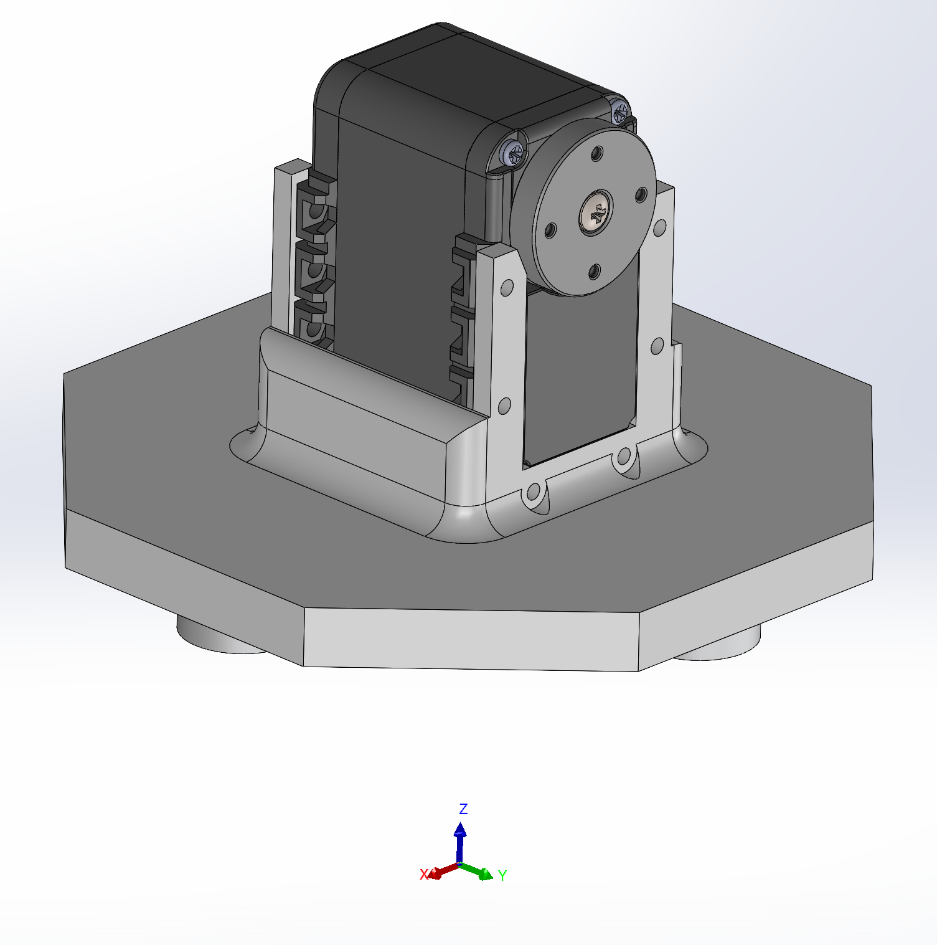
Link 1 - The base is hidden because it does not rotate, but the model coordinate system of this link is where the bottom of the base would be
Mass = 99.1 grams
Position of COM from the model coordinate system:
Center of mass: ( millimeters )
X = 2.74
Y = 0.67
Z = 68.49
Moments of inertia: ( grams * square millimeters )
Taken at the center of mass and aligned with the model coordinate system.
Lxx = 77132.67 Lxy = -181.32 Lxz = -5500.03
Lyx = -181.32 Lyy = 63015.08 Lyz = 1155.98
Lzx = -5500.03 Lzy = 1155.98 Lzz = 70263.49

Slide 9
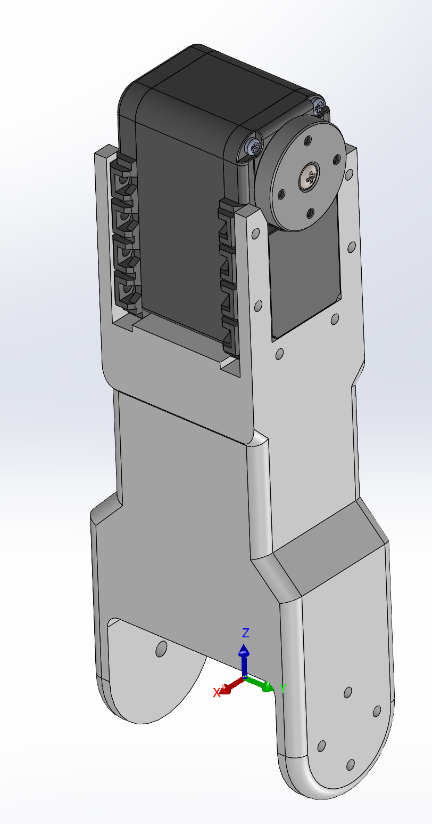
Link 2 - The model coordinate system is where it connects to link 1
Mass = 87.5 grams
Position of COM from the model coordinate system:
Center of mass: ( millimeters )
X = 0.00
Y = 0.75
Z = 82.23
Moments of inertia: ( grams * square millimeters )
Taken at the center of mass and aligned with the model coordinate system.
Lxx = 122510.29 Lxy = -0.01 Lxz = 0.04
Lyx = -0.01 Lyy = 115999.61 Lyz = 1817.51
Lzx = 0.04 Lzy = 1817.51 Lzz = 17810.74

Slide 10
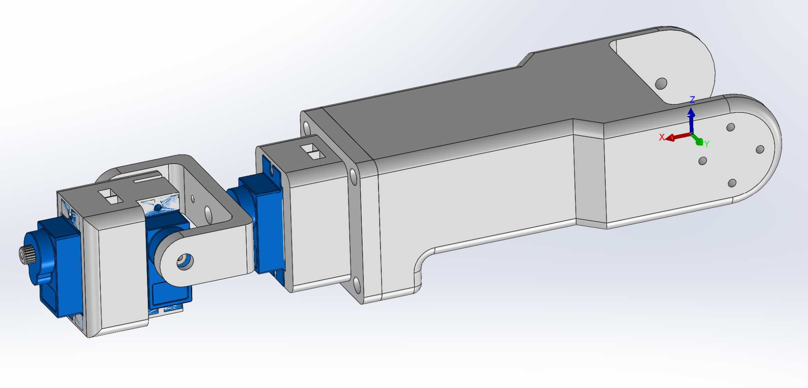
Link 3 - The model coordinate system is where it connects to link 2
Mass = 77.8 grams
Position of COM from the model coordinate system:
Center of mass: ( millimeters )
X = 98.77
Y = -0.14
Z = 1.96
Moments of inertia: ( grams * square millimeters )
Taken at the center of mass and aligned with the model coordinate system.
Lxx = 15196.78 Lxy = -469.99 Lxz = -10490.12
Lyx = -469.99 Lyy = 206802.72 Lyz = 22.98
Lzx = -10490.12 Lzy = 22.98 Lzz = 209462.11

